Slide 1

MACHINE LEARNING REGRESSION
LOGISTIC
REGRESSION

Slide 2
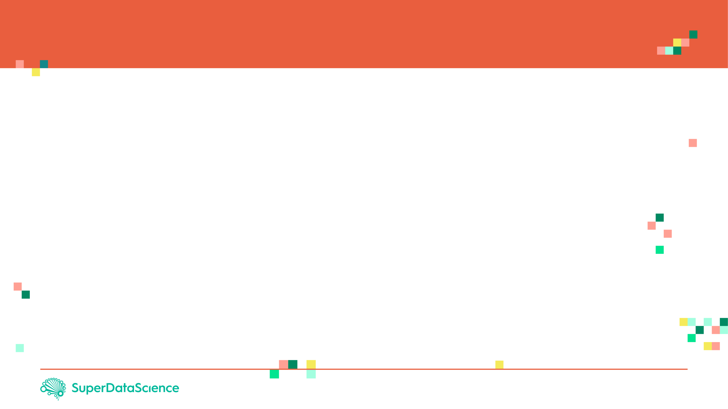

LOGISTIC REGRESSION: INTUITION
Linear regression is used to predict outputs on a continuous spectrum.
Example: predicting revenue based on the outside air temperature.
Logistic regression is used to predict binary outputs with 2 possible values (0 or 1)
Logistic model output can be one of two classes: pass/fail, win/lose, healthy/sick
Hours Studying | Pass/Fail
1 | 0
1.5 | 0
2 | 0
3 | 1
3.25 | 0
4 | 1
5 | 1
6 | 1
PASS/FAIL
LINEAR MODEL
HOURS OF STUDYING

Slide 3
LOGISTIC REGRESSION: INTUITION
Linear regression is not suitable for classification problem.
Linear regression is unbounded, so logistic regression will be better candidate in which the output value ranges from 0 to 1.
LINEAR MODEL
PASS/FAIL
LOGISTIC REGRESSION MODEL
HOURS OF STUDYING

Slide 4

LOGISTIC REGRESSION: MATH
Linear regression is not suitable for classification problem.
Linear regression is unbounded, so logistic regression will be better candidate in which the output value ranges from 0 to 1.
Linear equation:
$y=b_{0}+b_{1}∗x$
Apply Sigmoid function:
$P\left(x\right)= sigmoid \left(y\right)$
$P\left(x\right)=\frac{1}{1+e^{−y}}$
$P\left(x\right)=\frac{1}{1+e^{−(b_{0}+b_{1}∗x)}}$
PASS/FAIL
LOGISTIC REGRESSION MODEL
HOURS OF STUDYING

Slide 5

LOGISTIC REGRESSION: FROM PROBABILITY TO CLASS
Now we need to convert from a probability to a class value which is “0” or “1”.
Linear equation:
$y=b_{0}+b_{1}∗x$
Apply Sigmoid function:
$P\left(x\right)= sigmoid \left(y\right)$
$P\left(x\right)=\frac{1}{1+e^{−y}}$
Class 1
LOGISTIC REGRESSION MODEL
PASS/FAIL
0.5
Class 0
THRESHOLD
HOURS OF STUDYING

Slide 6
MACHINE LEARNING REGRESSION
PERFORMANCE ASSESSMENT

Slide 7
CONFUSION MATRIX
TRUE CLASS
+
-
TYPE I ERROR
+
TRUE +
FALSE +
PREDICTIONS
FALSE -
TRUE -
-
TYPE II ERROR

Slide 8
CONFUSION MATRIX
A confusion matrix is used to describe the performance of a classiﬁcation model:
True positives (TP): cases when classiﬁer predicted TRUE (they have the disease), and correct class was TRUE (patient has disease).
True negatives (TN): cases when model predicted FALSE (no disease), and correct class was FALSE (patient do not have disease).
False positives (FP) (Type I error): classiﬁer predicted TRUE, but correct class was FALSE (patient did not have disease).
False negatives (FN) (Type II error): classiﬁer predicted FALSE (patient do not have disease), but they actually do have the disease

Slide 9
KEY PERFORMANCE INDICATORS (KPI)
Classiﬁcation Accuracy = (TP+TN) / (TP + TN + FP + FN)
Misclassiﬁcation rate (Error Rate) = (FP + FN) / (TP + TN + FP + FN)
Precision = TP/Total TRUE Predictions = TP/ (TP+FP) (When model predicted TRUE class, how often was it right?)
Recall = TP/ Actual TRUE = TP/ (TP+FN) (when the class was actually TRUE, how often did the classiﬁer get it right?)

Slide 10
PRECISION Vs. RECALL EXAMPLE
TRUE CLASS
+
-
TP = 1
FP = 1
+
PREDICTIONS
-
FN = 8
TN = 90
Classiﬁcation Accuracy = (TP+TN) / (TP + TN + FP + FN) = 91%
Precision = TP/Total TRUE Predictions = TP/ (TP+FP) = ½=50%
Recall = TP/ Actual TRUE = TP/ (TP+FN) = 1/9 = 11%

